Slide 1

Cone Health PGY2 Pharmacy Residency Programs
2026 Overview

Slide 2
PGY2 Residency Opportunities at Cone Health
We would like to share our pgy2 residency highlights with you.
Reach out to any of the current residents or RPDs with questions!
OUR PGY2 PROGRAMS PREPARE RESIDENTS FOR SPECIALIST POSITIONS IN THEIR FIELDS.

Slide 3
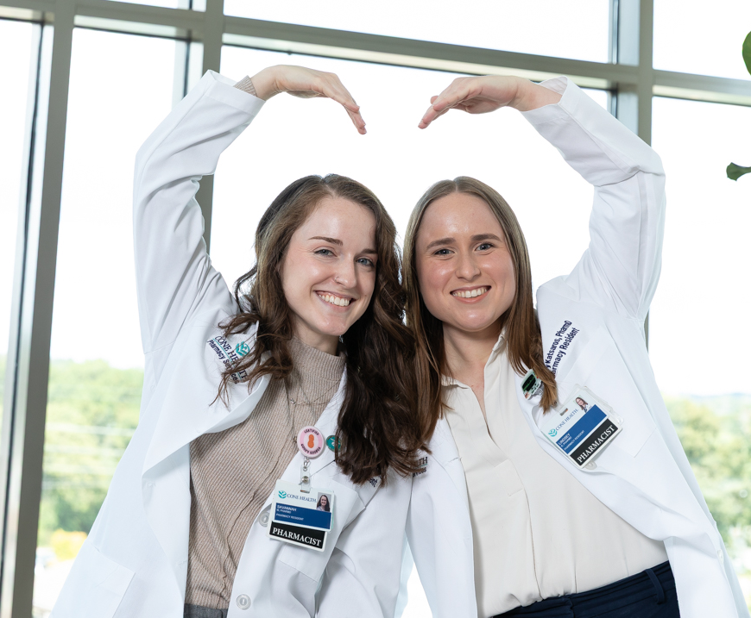
PGY2 Cardiology
Required Rotations:
Emergency Medicine / Medical ICU
Cardiac Intensive Care I & II
Heart Failure I & II
Electrophysiology
Interventional Cardiology
Cardiac Surgery
CVRR or HF Clinic
Elective Rotations:
Stroke/Neuro Critical Care
Cardiac Transplant
Heart Failure Stewardship
Pediatric Cardiology
Other options with inclusion of resident preference
Staffing Requirement:
Cardiac Intensive Care Unit every 3rd weekend
Longitudinal Experiences:
Research Project (Split Model)
EBM Series (CE presentation)
Longitudinal CVRR & HF Clinic
Formalized Mentor Program
Preceptor Development Forum
Teaching Certificate (optional)
Current Residents: Lindsey Katsaros, PharmD (lindsey.katsaros@conehealth.com) and Savannah Salam, PharmD (savannah.salam@conehealth.com)
RPD: Lisa Curran, PharmD, BCPS, BCCP, CPP (lisa.curran@conehealth.com)

Slide 4
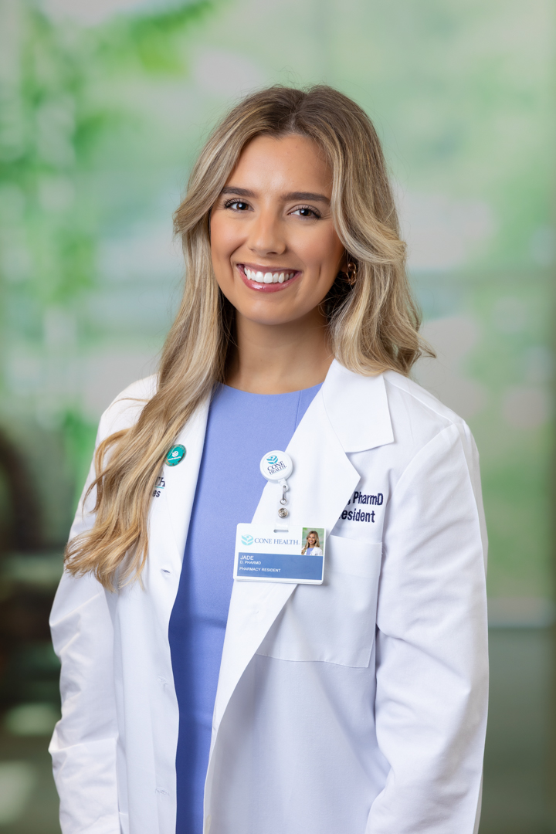
PGY2 Critical Care
High acuity, fast paced environment
  Annual average: ~3,400 ICU admissions
  MICU:30 beds
  CV/Surgical ICU:28 beds
  Neuro/Trauma ICU:31 beds
Interdisciplinary bedside patient rounds
High scope of practice with a variety of pharmacy led protocols
  ICU Insulin Titration, Phenobarbital Dosing for AWS, Bowel Regimen
Longitudinal experiences: ECMO, Code Blue response, critical care medication safety review, HPU lecture, research project, medication use evaluation, and more!
Orientation
Medical Intensive Care I
Medical Intensive Care II
Neuro Intensive Care
Emergency Medicine / Toxicology
Cardiovascular Intensive Care
Advanced Nutrition
Infectious Disease
Trauma Intensive Care
Required Learning Experiences
Current Resident (Pictured): Jade Denninger, PharmD (jade.denninger@conehealth.com)
RPD: Jessica Millen, PharmD, BCPS, BCCCP (jessica.millen@conehealth.com)
RPC: Heather Wilson, PharmD, BCCCP (heather.wilson2@conehealth.com)
Contact us with any questions!

Slide 5

PGY2 Infectious Diseases
Numerous stewardship opportunities
Robust ambulatory ID clinic with 2 clinical pharmacist practitioners
Teaching opportunities through High Point University and precepting
Elective Rotations
Specialty Pharmacy
Internal Medicine/Precepting
Emergency Medicine
Other experiences may be tailored based on resident interests
Longitudinal experiences
Research
ID Journal Clubs (local and state presentations)
Staffing (Med surg floor clinical every 3rd weekend)
Formalized mentor program
CE presentation
Antimicrobial stewardship committee team member
Teaching certificate (optional)
Required Rotations
3 months antimicrobial stewardship
3 months ID consult
ID clinic (half a day once weekly + full month experience)
Critical Care
Current Resident: Blake Wannarat (blake.wannarat@conehealth.com)
RPD: Jeremy Frens, PharmD, BCIDP (Jeremy.frens@conehealth.com)
RPC: Emily Sinclair, PharmD, BCPS, BCIDP (emily.sinclair@conehealth.com)
Contact us with any questions!

Slide 6
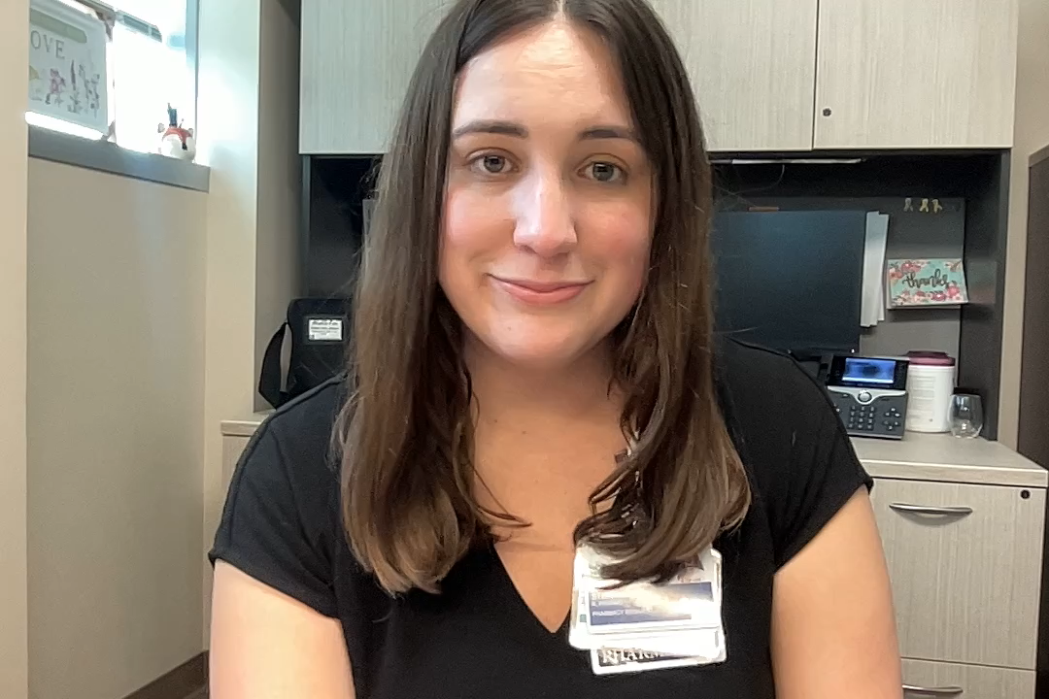
PGY2 Oncology
Required Rotations
Outpatient Malignant Hematology
Breast Cancer Clinic
Lung Cancer
GU Oncology
GI Oncology
Oncology Administration
Pediatric Oncology (case based)
Elective Rotations
Gynecologic Oncology
Head and Neck Cancers
Neuro Oncology
Oral Chemotherapy Clinic
Palliative Care
Nutrition Support
Acute Leukemia/Lymphoma & BMT
Ambulatory oncology and hematology focused residency
Longitudinal Experiences
Research Project & MUE
Oncology P&T Subcommittee
Strong patient care, clinical research, leadership, and education opportunities
Medication Safety Review
Beacon Oncology Protocol Review
Weekly Journal Club Presentations
Ability to practice within Cone Health's six cancer centers
Infusion & Oral Chemo Staffing
Teaching at HPU School of Pharmacy
Student & Resident Precepting
Current Resident: Andrea Dobbs, PharmD (andrea.dobbs@conehealth.com)
RPD: Rebecca Cottle, PharmD, BCPS, BCOP (rebecca.cottle@conehealth.com)
RPC: Carol Jones, PharmD (carol.jones2@conehealth.com)

Slide 7
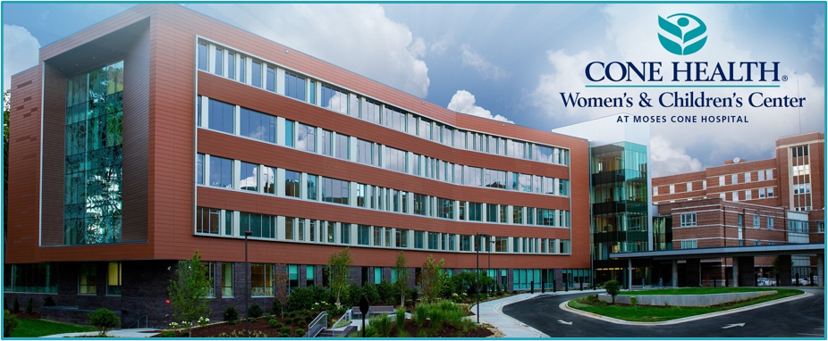
PGY2 Pediatrics
PGY1 Elective Learning Experiences
PGY2 Learning Experiences
4 bed Pediatric Intensive Care Unit
Neonatal Intensive Care Unit
49 bed Level III NICU
High-Risk Obstetrics, Labor and Delivery, Maternity Assessment, and Mother-Baby
Interdisciplinary rounds
Interdisciplinary rounds on teaching service
Family medicine residents and OB Fellows
Pediatrics
18 bed General Pediatric Unit
Teaching service staffed by UNC Pediatric Medicine Residency Program
Interdisciplinary rounds on teaching service
Obstetrics
Required Rotations
Project Management (Flipped Research Model)
Orientation
General Pediatrics
Neonatal Intensive Care Unit I
High Risk Obstetrics
Pediatric Intensive Care (offsite)
Pediatric Administration
Neonatal Intensive Care Unit II
Pediatric Emergency Department
Longitudinal Rotations:
Pharmacy Practice Management
Medication Safety and Quality
Teaching and Precepting
Ambulatory Pediatric Specialists Complex Care Clinic
Pediatric Population Health
Opportunities for all residents in code response, clinical research, leadership and committee involvement, & teaching and education
Current Resident: Madison Kalke, PharmD (madison.kalke@conehealth.com)
RPD: Allie Rivera, PharmD, MHSA, BCPPS (allie.rivera@conehealth.com)
RPC: Tanya Makhlouf, PharmD, BCPPS (tanya.makhlouf@conehealth.com)

Slide 8
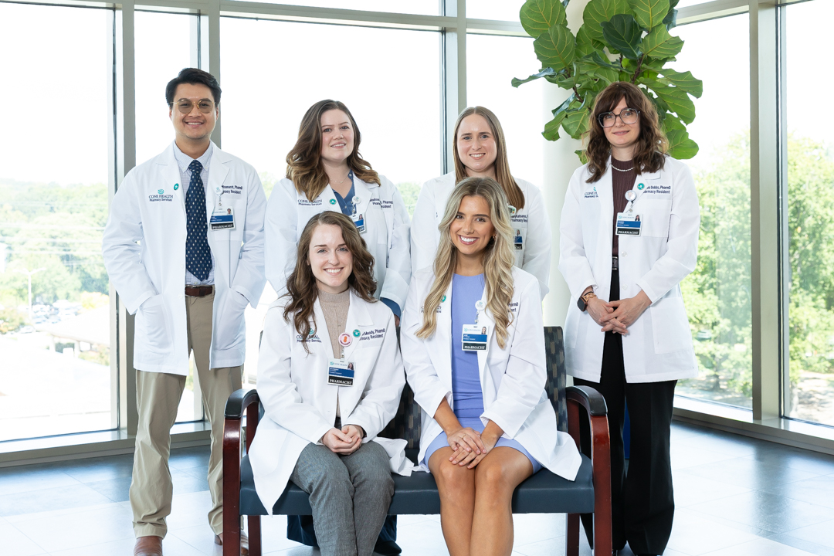
For more information, please visit our website!
Pharmacy Residency | Cone Health

